Slide 1
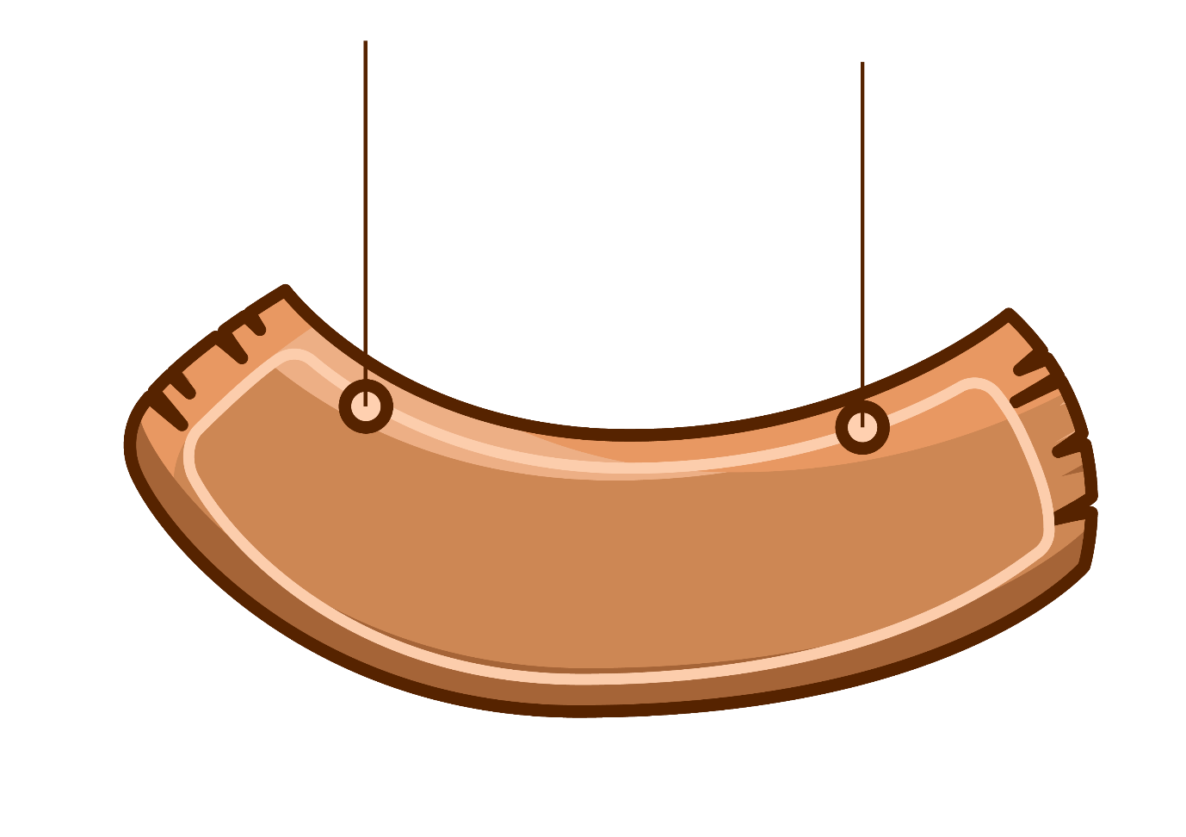
Warm- up: Pelmanism
1
2
3
Historic
Noisy
Narrow
4
5
6
Peaceful
Wide
Modern
Fighting
Fighting
7
8
9
boring
exciting

Slide 2
Wednesday, November 18th 2020
Period 30 - Unit 4 – Lesson 3
A closer look 2
Teacher: Nguyen Minh Hong

Slide 3
Wednesday, November 18th 2020
Period 30 - Lesson 3- A closer look 2
1
Counting syllables
Hot, tall
1 syllable
Short adjective
Modern, boring
2 syllables
Beautiful, expensive
3 syllables
Long adjective
Convenient
More than 3 syllables

Slide 4
Wednesday, November 18th 2020
Period 30 - Lesson 3- A closer look 2
2
Comparative of short adjectives
Short Adj with
1 syllable:
Short Adj with 2 syllables
(special endings): y, ow, et, er, le
Let’s learn
Short -> Shorter
Happy -> Happier
Tall -> Taller
Narrow -> Narrower
NOTES:
Slim -> Slimmer
Big -> Bigger
Clever -> Cleverer
Quiet -> Quieter
Simple -> Simpler

Slide 5
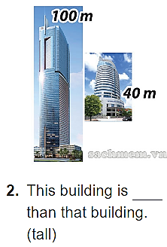
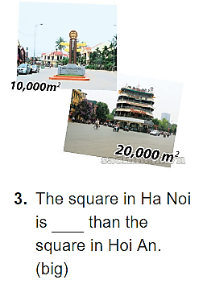
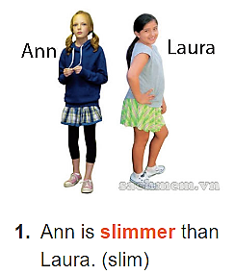
Wednesday, November 18th 2020
Period 30 - Lesson 3- A closer look 2
3
Practice 1
taller
bigger

Slide 6
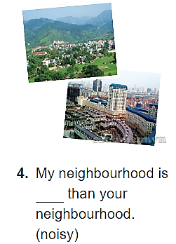
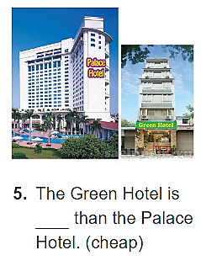
Wednesday, November 18th 2020
Period 30 - Lesson 3- A closer look 2
3
Practice 1
noisier
cheaper

Slide 7
Wednesday, November 18th 2020
Period 30 - Lesson 3- A closer look 2
4
Comparative of long adjectives
LONG Adj with
2 syllables:
LONG Adj with 3 syllables and more
Let’s learn
- Beautiful -> more beatiful
Modern -> more modern
Boring -> more boring
- Convenient -> more convenient

Slide 8
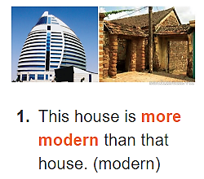
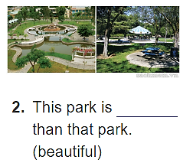
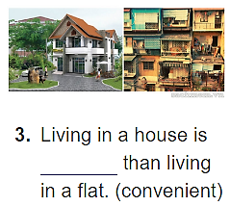
Wednesday, November 18th 2020
Period 30 - Lesson 3- A closer look 2
5
Practice 2
more beautiful
more convenient

Slide 9
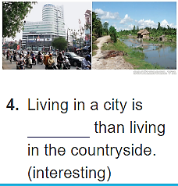
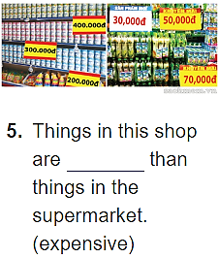
Wednesday, November 18th 2020
Period 30 - Lesson 3- A closer look 2
5
Practice 2
more expensive
more interesting

Slide 10
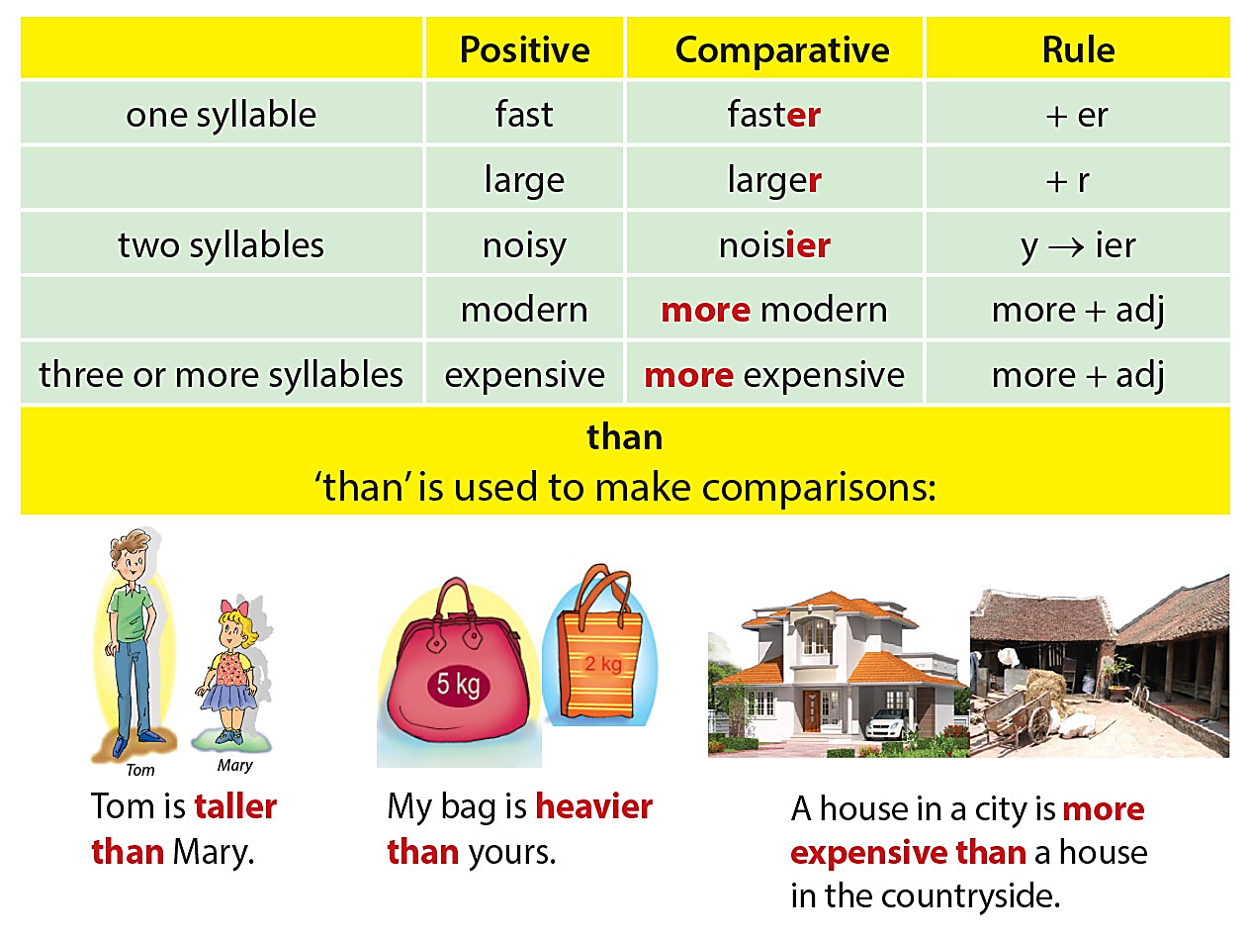
Wednesday, November 18th 2020
Period 30 - Lesson 3- A closer look 2
6
How to make comparisons

Slide 11
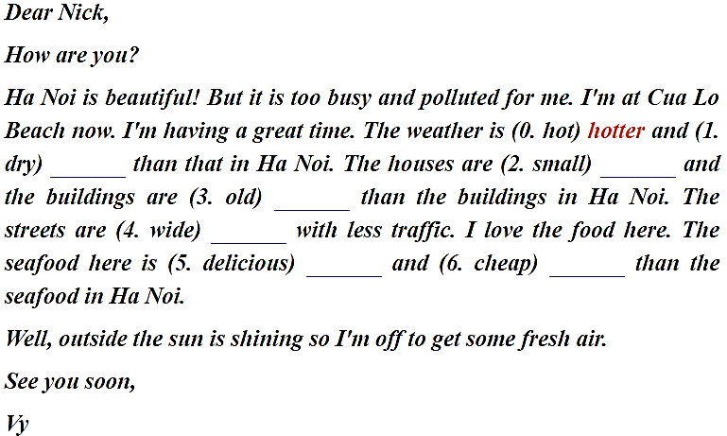
Wednesday, November 18th 2020
Period 30 - Lesson 3- A closer look 2
7
Practice 3
drier
smaller
older
wider
more delicious
cheaper

Slide 12
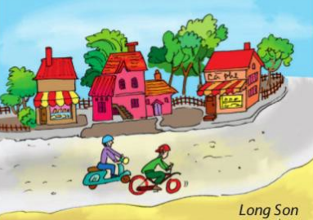
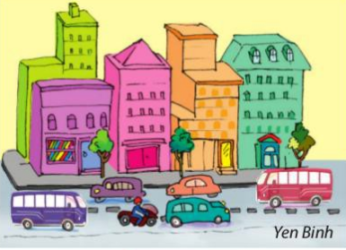
Wednesday, November 18th 2020
Period 30 - Lesson 3- A closer look 2
7
Practice 3
Yen Binh:
noisy
modern
narrow
expensive
Long Son:
peaceful
historic
wide
cheap
noisier
Yen Binh is _________ than Long Son.
more
peaceful
Long Son is _________ than Yen Binh.

Slide 13
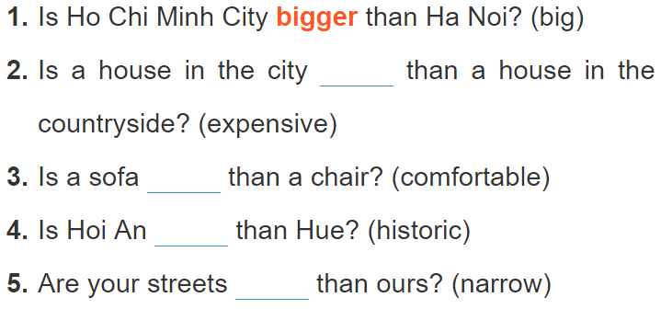
Wednesday, November 18th 2020
Period 30 - Lesson 3- A closer look 2
7
Practice 3

Slide 14
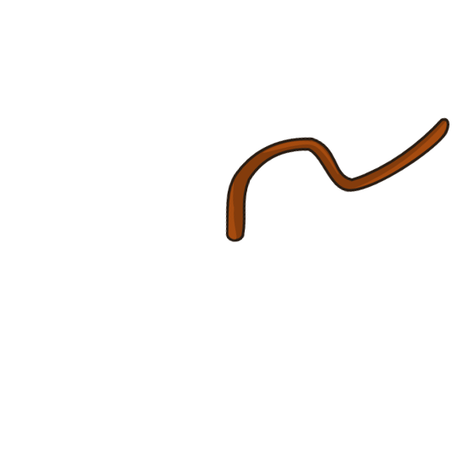
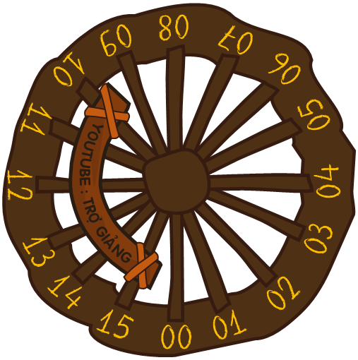
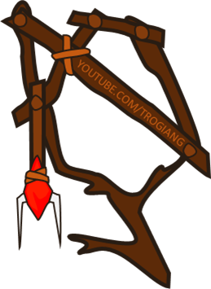
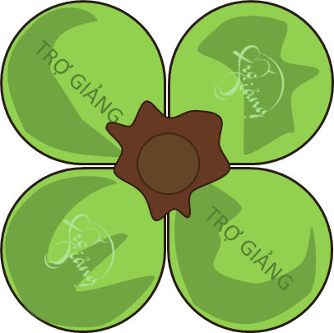
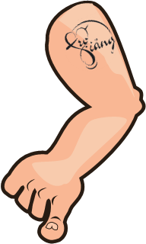
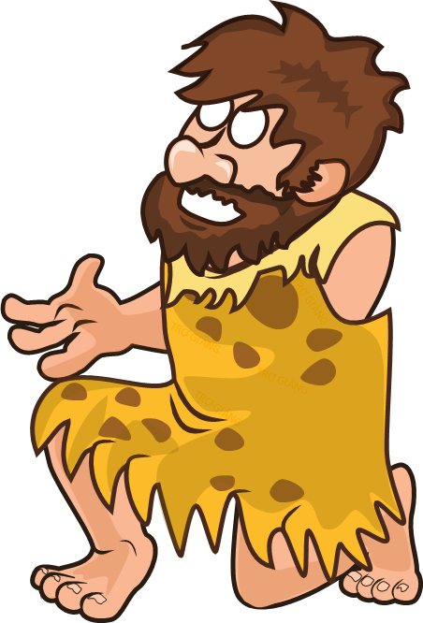
For you, what happens when the original human see a balloon.
Of course, he would manage to find ways how to attack it for self defince.
Try to let the balloon fly far way from him.
HOW TO PLAY :
Students: Students answers the questions quickly to within 15 second ( Muti answers may be given continuosly until there is a correct answer ).
Teacher : If the student answers correctly then teacher just click on the screen.
And click on the stone icon to continue the following questions.
..
GAME
BALLOONS
Notes:
Theo bạn, điều gì xảy ra khi một người nguyên thủy nhìn thấy một quả bóng bay.
Tất nhiên, anh ta sẽ tìm cách tấn công nó để tự vệ.
Hãy giúp quả bóng bay tránh xa anh ta.
Cách chơi :
Học sinh: Học sinh trả lời thật nhanh câu hỏi trong vòng 15 giây ( Có thể đưa ra nhiều đáp án liên tục cho đến khi có đáp án đúng ).
Giáo viên : Nếu học sinh trả lời đúng chỉ cần bấm vào màn hình.
Bấm vào hòn đá có biểu tượng người để qua câu tiếp theo.

Slide 15
Question 1: Is Ho Chi Minh City _____ than Ha Noi? (big)
bigger
Q1
!!!
ANSWER
NEXT

Slide 16
Question 2: Is a house in the city _________ than a house in the countryside? (expensive)
more expensive
Q2
!!!
ANSWER
NEXT

Slide 17
Question 3: Is a sofa _______________ than a chair? (comfortable)
more comfortable
Q3
!!!
ANSWER
NEXT

Slide 18
Question 4: Is Hoi An ____________ than Hue? (historic)
more historic
Q4
!!!
ANSWER
NEXT

Slide 19
Question 5: Are your streets _________ than ours? (narrow)
narrower
Q5
!!!
ANSWER
NEXT

Slide 20
Wednesday, November 18th 2020
Period 30 - Lesson 3- A closer look 2
7
Practice 3
more expensive
more comfortable
more historic
narrower

Slide 21
Wednesday, November 18th 2020
Period 30 - Lesson 3- A closer look 2
7
Practice 3
Yen Binh:
noisy
modern
narrow
expensive
Long Son:
peaceful
historic
wide
cheap
Is Yen Binh more crowded than Long Son.
Yes, it is.
Is Long Son more modern than Yen Binh?
No, it isn’t.

Slide 22
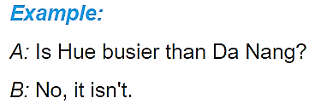
Wednesday, November 18th 2020
Period 30 - Lesson 3- A closer look 2
7
Practice 3

Slide 23
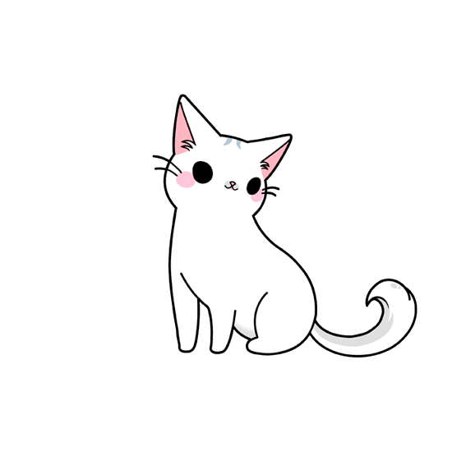
Wednesday, November 18th 2020
Period 30 - Lesson 3- A closer look 2
7
Practice 3
1. Write 5 sentences using comparative adjectives.
HOMEWORK
2. Prepare “communication”

